Slide 1
Collaborative Filtering in RS

Slide 2
Learning Objectives
Introduction to collaborative filtering and how it works in RS
Matrix Factorization Based approach using SVD
Performing SVD on different dataset
Hands on exercise on collaborating filtering models
2

Slide 3
Introduction to collaborative filtering
Collaborative filtering, also referred to as social filtering, filters information by using the recommendations of other people.
For each user, recommender systems recommend items based on how similar users liked the item.
For eg:, A person who wants to see a movie for example, might ask for recommendations from friends. The recommendations of some friends who have similar interests are trusted more than recommendations from others. This information is used in the decision on which movie to see.

Slide 4
Types of CF
Item based CF : Compute similarity between items
User based CF : Compute similarity between users

Slide 5
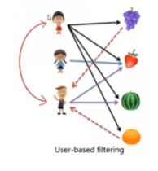
User based CF
Identify users who have a similar taste of products.
Similarity of the users is based upon their purchasing behaviour.
Memory-based: the rating matrix is directly used to find neighbours / make predictions.

Slide 6
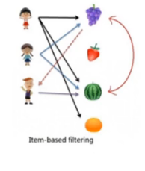
Item based CF
Users are recommended based on the item they bought.
Similarity is based upon the co-occurence of purchases:
Similarity between items (and not users) is considered to make predictions

Slide 7

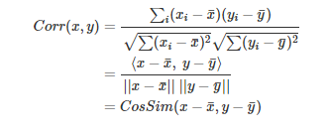
How to compute similarity
Cosine similarity
Pearson similarity

Slide 8
User based CF Vs. Item based CF
IBCF is more efficient than UBCF
Typical applications involve far more Users than items. Hence Similarity matrix for IBCF is more compact than UBCF.
Similarity estimates between items is more likely to converge over time than similarity between users.
However, the IBCF recommendations tend to be more conservative than UBCF.

Slide 9
Strengths and issues of CF
Strengths
Content- agnostic
Does not require items or users to be related with the content information.
Recommendations are very personalised in this case
Issues
Cold start problem
Sparsity
Popularity bias
Scalability

Slide 10
Market basket analysis
Discovers co-occurrence relationships among activities performed.
Market basket analysis can be used to divide customers into groups
Market basket analysis may provide the retailer with information to understand the purchase behavior of a buyer.
“customers who bought book A also bought book B”
When one super market chain discovered in its analysis that male customers that bought diapers often bought beer as well, have put the diapers close to beer coolers, and their sales increased dramatically.
Might tell a retailer that customers often purchase shampoo and conditioner together, so putting both items on promotion at the same time would not create a significant increase in revenue, while a promotion involving just one of the items would likely drive sales of the other.

Slide 11

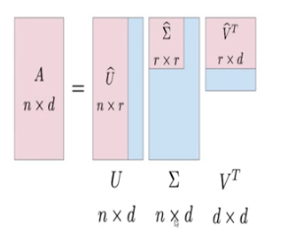
Matrix Factorization Based approach using SVD
What is SVD?
SVD can be used to decompose any given matrix, M into a product of 3 matrices as follows:
Where U and V are called left and right singular vectors.

Slide 12
Performing SVD on different dataset
Some important functions
Importing libraries
import numpy as np
import time
from sklearn.externals import joblib
import Recommenders as Recommenders
import Evaluation as Evaluation
2. Load the data and print the length
movie_df_1 = pandas.read_csv('./ratings.csv')
print(movie_df_1.head())
len(movie_df_1)

Slide 13
3. Create a subset of the dataset
movie_df = movie_df.head(10000)
4. Showing the most popular movies in the dataset
movie_grouped = movie_df.groupby(['movieId']).agg({'rating': 'count'}).reset_index()
grouped_sum = movie_grouped['rating'].sum()
print(grouped_sum)
movie_grouped['percentage'] = movie_grouped['rating'].div(grouped_sum)*100
movie_grouped.sort_values(['rating', 'movieId'], ascending = [0,1])
5. Count the number of unique movies in the dataset
movies = movie_df['movieId'].unique()
len(movies)

Slide 14
6. Create an instance of popularity based recommender class
pm = Recommenders.popularity_recommender_py()
pm.create(train_data, 'userId', 'movieId')
7. Use the popularity based model to make predictions for the following user id
user_id = users[8]
pm.recommend(user_id)
8. Create an instance of item similarity based recommender class
is_model = Recommenders.item_similarity_recommender_py()
is_model.create(train_data, 'userId', 'movieId')

Slide 15
Hands on exercise on collaborating filtering models
User & Item based Collaborative Filtering
Some important functions to look into
Import libraries, load the data and get the shape of data
import pandas as pd
import numpy as np
ratings = pd.read_csv("../data/ratings_sub.csv",encoding = "ISO-8859-1")
ratings.shape
2. Find the top 10 most popular movies watched
print("total unique users - ",len(ratings["userId"].unique()))
3. Who are the users with maximum no of movies watched?
ratings["userId"].value_counts().head()

Slide 16
4. Transforming data to surprise format
from surprise import Dataset,Reader
reader = Reader(rating_scale=(1, 5))
# Split data to train and test
from surprise.model_selection import train_test_split
trainset, testset = train_test_split(data, test_size=.25,random_state=123)
5. SVD Based Recommendation
movie_count = ratings["title"].value_counts(ascending=False)
pop_movie = movie_count.loc[movie_count.values > 200].index
len(pop_movie)

Slide 17
from surprise import SVD
from surprise import accuracy
6. Recreating the SVD predictions using Matrix multiplcation of User and Item factors
user_factors = svd_model.pu
user_factors.shape
item_factors = svd_model.qi
item_factors.shape
pred = np.dot(user_factors,np.transpose(item_factors))

Slide 18
7. Computing Similarity Matrix
import numpy as np
item_sim = np.corrcoef(item_factors)
max_val = (-item_sim).argsort()
topk = pd.DataFrame(max_val[:,0:20])
# create item iid dictionary
all_movies = [trainset.to_raw_iid(x) for x in range(0,567)]
movie_iid_dict = dict(zip(range(0,567), all_movies))
topk = topk.replace(movie_iid_dict)
topk["movie"] = all_movies
topk.to_csv("sim_movies_svd.csv",index=False)

Slide 19


Slide 20


Questions?

